Slide 1
SOFTWARE TESTING AND QUALITY ASSURANCE
DINH THI MY CANH

Slide 2
Hình thức đánh giá
Điểm quá trình: 40%
Điểm danh + Một số bài thực hành + báo cáo
Cuối kỳ: 60%
Thi vấn đáp

Slide 3
References
1. Kshirasagar Naik And Priyadarshi Tripathy, Software Testing And Quality Assurance, Theory And Practice, 2008, John Wiley & Sons, Inc.
2. Phạm Ngọc Hùng, Trương Anh Hoàng và Đặng Văn Hưng, Giáo trình kiểm thử phần mềm, tháng 1 năm 2014.
3. https://www.softwaretestinghelp.com

Slide 4
Contents
Chapter 1: Basic Concepts
Chapter 2: Unit Testing
Chapter 3: Control Flow Testing
Chapter 4: Data Flow Testing
Chapter 5: System Integration Testing
Chapter 6: System Testing

Slide 5
Contents
Chapter 7: Functional Testing
Chapter 8: Model Based Testing
Chapter 9: System Test Design
Chapter 10: Acceptance Testing
Chapter 11: Software Quality Assurance
Chapter 12: Maturity Model and Quality Standards

Slide 6
Chapter 1: Basic Concepts
kh

Slide 7
Contents
Quality revolution
Software quality
Verification and validation
Failure, error, fault, and defect
Testing, QA, QC
Role of testing

Slide 8
Contents
Objectives of testing
Test case
Test levels
Sources of information for test case selection
White-box and black- box testing
Test Planning

Slide 9
1.Quality revolution
Started in Japan by Deming, Juran, and Ishikawa during 1940s
In 1950s, Deming introduced statistical quality control to Japanese engineers
Statistical quality control (SQC) is a discipline based on measurement and statistics
SQC methods use seven basic quality management tool
Pareto analysis, Trend Chart, Flow chart, Histogram, Scatter diagram, Control chart, Cause and effect diagram

Slide 10
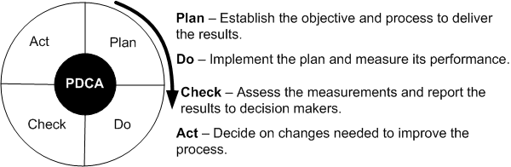

1.Quality revolution
“Lean principle” was developed by Taiichi Ohno of Toyota
“A systematic approach to identifying and eliminating waste through continuous improvement, flowing the product at the pull of the customer in pursuit of perfection.”

Slide 11
1.Quality revolution
In 1954, Juran spurred the move from SQC to TQC (Total Quality Control)
Key Elements of TQC:
Quality comes first, not short-term profits
The customer comes first, not the producer
Decisions are based on facts and data
Management is participatory and respectful of all employees
Management is driven by cross-functional committees

Slide 12
1.Quality revolution
National Broadcasting Corporation (NBC) of United States broadcast a documentary
“If Japan Can ... Why Can’t We?” on June 24th, 1980
Leaders in United States started emphasizing on quality
In 1987 Malcolm Baldrige National Quality Award was introduced in U.S.A
Similar to the Deming prize in Japan
In Baldrige National Award the quality is viewed as:
Something defined by the customer
In Deming prize, the quality is viewed as:
Something defined by the producer by conformance to specifications

Slide 13
2. Software quality
Five Views of Software Quality:
Transcendental view
User’s view
Manufacturing view
Product view
Value-based view

Slide 14
2. Software quality
Software Quality in terms of quality factors and criteria
A quality factor represents behavioral characteristic of a system
Examples: correctness, reliability, efficiency, and testability
A quality criterion is an attribute of a quality factor that is related to software development
Example: modularity is an attribute of software architecture
Quality Models
Examples: ISO 9126, CMM, TPI, and TMM

Slide 15
3.Verification and validation
Verification
Evaluation of software system that help in determining whether the product of a given development phase satisfy the requirements established before the start of that phase
Building the product correctly
Validation
Evaluation of software system that help in determining whether the product meets its intended use
Building the correct product
V&V

Slide 16
4. Failure, error, fault, and defect
Failure
A failure is said to occur whenever the external behavior of a system does not conform to that prescribed in the system specification
Error
An error is a state of the system.
An error state could lead to a failure in the absence of any corrective action by the system
Fault
A fault is the adjudged cause of an error
Defect
It is synonymous of fault
It a.k.a. bug
Notes:
Fault: đặt chỉ số vòng lặp sai (do con người)
Error: Vòng lặp thực hiện nhiều lần (lỗi hệ thống)
Failure: Hệ thống hông báo: tràn bộ nhớ
Fault ->Error ->Failure

Slide 17
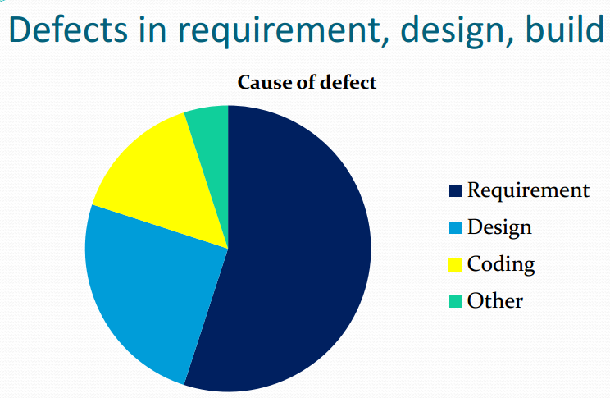
4. Failure, error, fault, and defect

Slide 18
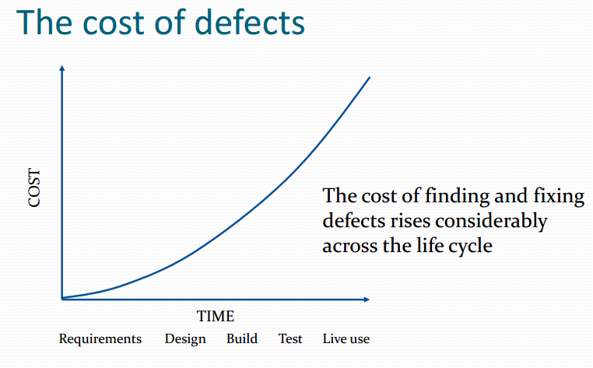
4. Failure, error, fault, and defect

Slide 19

5. QA, QC, Testing
Quality Assurance
A process for providing adequate assurance that the software products and processes in the product life cycle conform to their specific requirements and adhere to their established plans.
Quality Control
A set of activities designed to evaluate a developed working product.
Testing
The process of executing a system with the intent of finding defects including test planning prior to the execution of the test cases.

Slide 20
5. QA, QC, Testing
The key difference to remember is that
Quality Assurance is interested in the process whereas
Testing and Quality Control are interested in the product.
Having a testing component in your development process demonstrates a higher degree of quality (as in QA).

Slide 21
6. Role of testing (1)
Software quality assessment divide into two categories:
Static analysis
It examines the code and reasons over all behaviors that might arise during run time
Examples: code review, inspection, walk-through, algorithm analysis, and proof of correctness
Dynamic analysis
Actual program execution to expose possible program failure
One observe some representative program behavior, and reach conclusion about the quality of the system
Static and Dynamic Analysis are complementary in nature
Focus is to combines the strengths of both approaches
Notes:
Vai trò này dành cho developer test code

Slide 22
6. Role of the Testing (2)
The Testing Group provides important technical services, including:
Finding and reporting bugs.
Identifying weak areas of the program.
Identifying high risk areas of a project.
Explaining findings in ways that help
Engineering solve or fix the problems.
The customer service staff help customers.
Management make sound business decisions about each bug.
Notes:
Vai trò này dành cho tester

Slide 23
7. Objectives of testing
The Objective of Testing a Program is to Find Problems.
Finding problems is the core of your work. You should want to find as many problems as possible. The more serious the problem tester find, the better tester is.
A test that reveals a problem is a success. A test that did
not reveal a problem is (often) a waste of time!

Slide 24
8. Test case (1)
Test Case is a simple pair of
<input, expected outcome>
State-oriented: ATM is a state oriented system
Test cases are not that simple. A test case may consist of a sequences of <input, expected outcome>
The outcome depends both on the current state of the system and the current input
ATM example:
< check balance, $500.00 >,
< withdraw, “amount?” >,
< $200.00, “$200.00” >,
< check balance, $300.00 >
Notes:
Test case dành cho test code

Slide 25
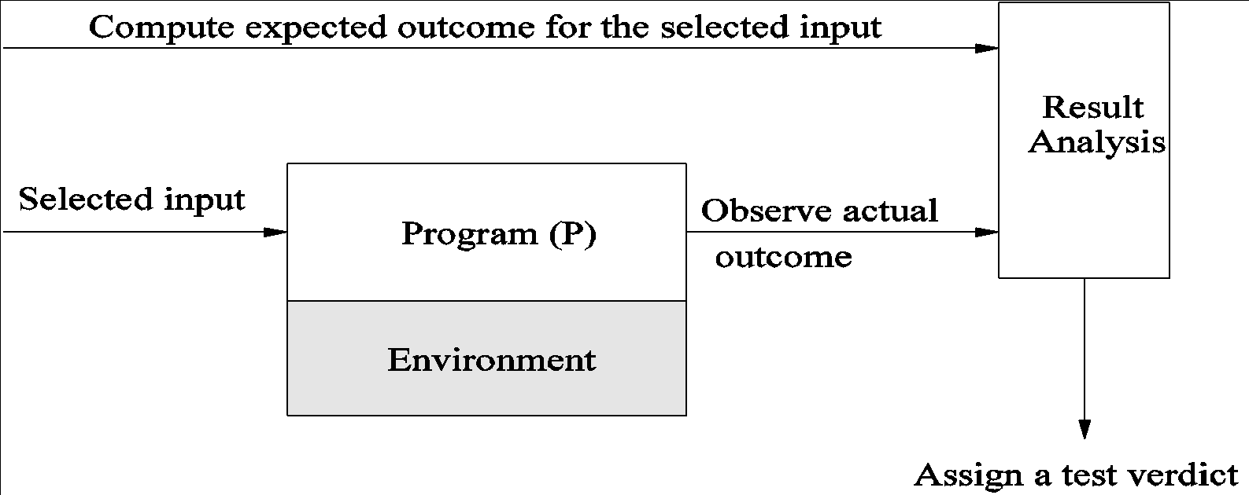
TESTING ACTIVITIES
Identify the objective to be tested
Select inputs
Compute the expected outcome
Set up the execution environment of the program
Execute the program
Analyze the test results

Slide 26
8. Test case (2)
Definition: A specific of test data and associated procedures developed for a particular objective, such as to exercise a particular program path or to verify compliance with a specific requirement (IEEE – 729-1983)
Definition: A test that (ideally) executes a single well defined test objective (i.e., a specific behavior of a feature under a specific condition) (Testing Computer Software – Kaner, Falk, Nguyen)
Notes:
Test case loại này dung để Test các chức năng của hệ thống

Slide 27
8. Test case
Why write test case?
Accountability
Reproducibility
Tracking
Verifying that tests are being executed correctly
Measuring test coverage
Finding bugs
Automation
Used as a training tool for new testers
For compliance

Slide 28
8. Test case
Things usually to include in a test case:
Tracking Information
Test Case ID
Test Description
– Purpose/Objective/Title
Procedures/Steps
Script
Parameters: Input, Output, Default, Options, Conditions…
Call to system (printer, system clock, available RAM, APIs)
Expected Result
Observed Result
Passed / Failed / Blocked / Skipped
Bug ID
Notes/Comments
Environment

Slide 29
8. Test case
The most important part of a test case is the 1-line title describing the objective of the test
That 1-line title can be called:
Test Title
Test Name
Test Case
Test Objective
Test Goal/Purpose

Slide 30
8. Test case
It is most important because
It gives the reader a description and idea of the test
A good test name makes review easier
Easier to pass to another person
Easier to pass to automation team
Describes intention of the test
In many cases, may be the only part of a test case
documented

Slide 31
8. Test case
Test Objective suggested syntax:
Action + Function + Operating Condition
In which:
Function may be function, feature, validation point
Condition may be data
Action:
Verify
Test
Validate
Prove
Execute
Print
Calculate
Run
…any action verb

Slide 32
Example
ID: 01
Description: Verify that user can login successfully.
Steps:
Navigate to the web application.
Enter valid username.
Enter valid password.
Click on ‘Login’ button.
Expected Result: User can login successfully. Welcome page displays with the text of Welcome Username.

Slide 33
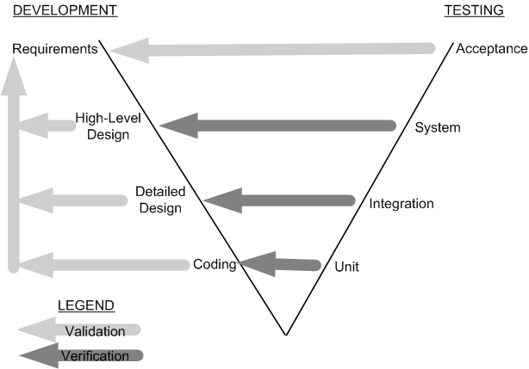
9. Test levels
Figure 1.7: Development and testing phases in the V model

Slide 34
9. Test levels
Unit testing
Individual program units, such as procedure, methods in isolation
Integration testing
Modules are assembled to construct larger subsystem and tested
System testing
Includes wide spectrum of testing such as functionality, and load
Acceptance testing
Customer’s expectations from the system
Two types of acceptance testing
UAT(User acceptance testing)
BAT (Business acceptance testing )
UAT: System satisfies the contractual acceptance criteria
BAT: System will eventually pass the user acceptance test
Notes:
User acceptance testing (UAT) Business acceptance testing (BAT)

Slide 35
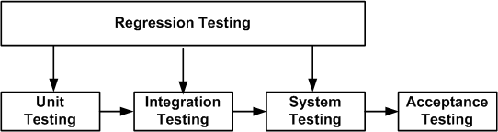
9. Test levels
Figure 1.8: Regression testing at different software testing levels
New test cases are not designed
Test are selected, prioritized and executed
To ensure that nothing is broken in the new version of the software

Slide 36
10. Sources of information for test case selection
Requirement and Functional Specifications
Source Code
Input and output Domain
Operational Profile
Fault Model
Error Guessing
Fault Seeding
Mutation Analysis

Slide 37
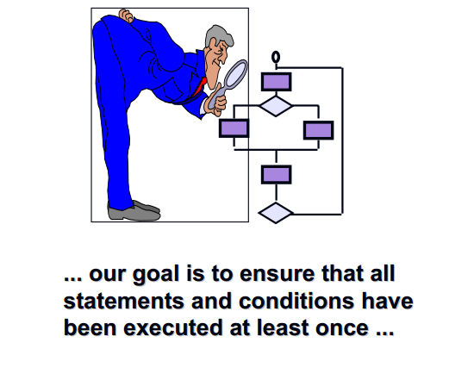
11. White-box and black- box testing

Slide 38
11. White-box and black- box testing
White-box testing a.k.a. structural testing
Examines source code with focus on:
Control flow
Data flow
Control flow refers to flow of control from one instruction to another
Data flow refers to propagation of values from one variable or constant to another variable
It is applied to individual units of a program
Software developers perform structural testing on the individual program units they write

Slide 39
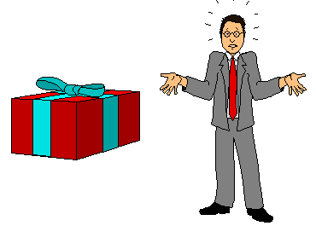
11. White-box and black- box testing

Slide 40
11. White-box and black- box testing
Black-box testing a.k.a. functional testing
Examines the program that is accessible from outside
Applies the input to a program and observe the externally visible outcome
It is applied to both an entire program as well as to individual program units
It is performed at the external interface level of a system
It is conducted by a separate software quality assurance group

Slide 41
12. Test Planning
The purpose is to get ready and organized for test execution
A test plan provides a:
Framework
A set of ideas, facts or circumstances within which the tests will be conducted
Scope
The domain or extent of the test activities
Details of resource needed
Effort required
Schedule of activities
Budget

Slide 42
THE END

